Slide 1
Software Development Tools
Lecture 6
COMP220/COMP285
Sebastian Coope
Eclipse and Java
These slides are mainly based on “Java Development with Eclipse” – D.Gallardo et al., Manning Publications., 2003

Slide 2
Eclipse
Eclipse is a quite complicated
Software Development Kit (SDK),
We will cover only
  The general description of Eclipse
    including the Java quick tour in Eclipse
  Using JUnit from inside of Eclipse
  Using Ant from inside of Eclipse (at the very end of our lectures after learning Ant)
Notes:
The next 2 weeks will be mostly devoted to Eclipse platform.

Slide 3
General description of Eclipse
Eclipse is a Software Development Kit (SDK)
It, may be compared to a blacksmith's shop, where you can
  not only make products,
  but also make the tools for making the products.

Slide 4
General description of Eclipse
At the most fundamental level, Eclipse is actually the Eclipse platform which
  integrates software development tools as Eclipse plug-ins.
Except of a small runtime kernel,
  everything is a plug-in or a set of related plug-ins.

Slide 5
General description of Eclipse
Most important plug-in is JDT (Java Development Toolkit)
  for writing and debugging Java programs.
In this form Eclipse is just Java IDE (Integrated Development Environment).
  This is what most people use Eclipse for.
  We too, because we will not create in these lectures our own plug-ins.
  However, we will use already existing plug-ins for JDT, Junit and Ant.

Slide 6
General description of Eclipse
Anyway, you should know that Eclipse contains PDE:
  Plug-in Development Environment
  it makes Eclipse easily extensible by other plug-ins.

Slide 7
General description of Eclipse
Although Eclipse is written in Java and mostly for creating Java projects, it is language neutral :
  additional plug-ins are available for other languages, such as C/C++, Cobol, and C#
But it is not strongly platform neutral :
  it uses the operating system's native graphics.

Slide 8
General description of Eclipse
The Eclipse platform consists of
  a small platform runtime kernel,
  workbench (GUI: menus, toolbars, perspectives, views and editors),
  workspace (to contain and manage projects),
  team support components,
  help

Slide 9
The Eclipse Architecture
General description of Eclipse
JDT
PDE
Your tool here
Workbench
Help
Workspace
(projects, files)
Team support
Platform runtime kernel
Except for small runtime kernel, everything in Eclipse is a plug-in or a set of related plug-ins

Slide 10
General description of Eclipse
Team support (plug-in):
  Facilitates the use of a version control or configuration management system.
  The Eclipse platform includes a client for Concurrent Versions System (CVS):
    a source control tool
    invaluable if two or more people work together on a single set of files – to coordinate changes.

Slide 11
Eclipse Workbench
Workbench
  main window which shows a perspective
Perspective:
  set of panes
Pane contains
  view(s) which can be tabbed
One pane serves as an editor

Slide 12
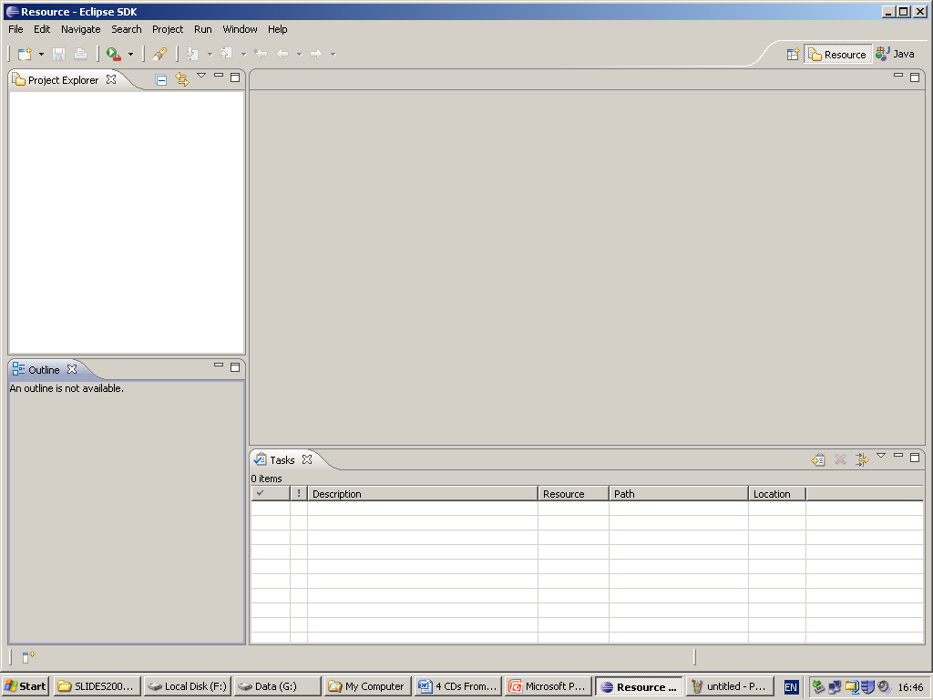
Eclipse Workbench - Resource perspective
Pane –
tabbed view
“Project Explorer”
Pane – typically used
for an editor
Pane –
tabbed view
“Outline”
Pane – contains tabbed view “Tasks”;
There can be many tabbed views in a pane

Slide 13
Eclipse Workbench
Resource Perspective is sometimes considered as home perspective:
  a general purpose perspective for
    creating, viewing, and managing all types of resources
  contains, in particular, Project Explorer (Navigator) view showing
    a hierarchical representation of the workspace and all the projects in it

Slide 14

Eclipse Workbench
Other perspectives are available
  either by clicking on perspective switcher icon (choose Other…) or
  on a perspective icons on shortcut toolbar in the right up corner
  or via
  Window > Open Perspective > Other…
  perspective switcher can be put, e.g., along the left side (as in the Eclipse book) by right clicking on .

Slide 15
Eclipse Workbench
Changing how a perspective looks like:
  Temporary supersizing a view by double-clicking on the title bar of the view
  moving views around by dragging their title bars
  adding a new view: Window > Show View
  closing a view
  restoring the perspective to its default appearance:
    Window > Reset Perspective
  saving your customized perspective:
    Window > Save Perspective As
Notes:
see also:
Window > Preferences > General > Perspectives > …

Slide 16
Eclipse Workbench
There are several standard types of projects in Eclipse:
  Java – the choice for developing a Java program
  Plug-in Development
    for creating your own plug-ins for Eclipse (will not be considered)
  etc.
Notes:
Simple
for documentation (will not be considered)

Slide 17
The Java quick tour in Eclipse
Creating a Java project
Right-click in the Project Explorer view in Resource perspective (or in the Package Explorer view in Java perspective ) and select
New > Project > Java Project > Next
to start New Java Project Wizard.
Enter the Project name, say Hello.
Choose “Create separate folders for sources and class files”.
  Otherwise your sources and (compiled) class files will be in the same root directory Hello.
(Note that clicking Next would take you to a dialog box that lets you change a number of Java build settings. For this example we don’t need to change anything.)
Click Finish.
Confirm switching to Java Perspective.
Notes:
Proj-Joint-Source-Classes
See next slide.

Slide 18
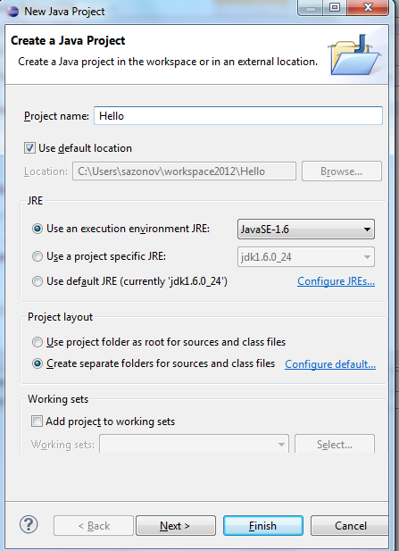
The Java quick tour in Eclipse
Creating a Java project
Hello
Notes:
Proj-Joint-Source-Classes

Slide 19
The Java quick tour in Eclipse
Creating a Java project
Create another similar project
  Proj-Joint-Source-Classes
  now with choosing
  “Use project folder as root for sources and class files”
  We will see the difference and use this version in a later exercise.
  See the result of your actions in the next slide
Notes:
Proj-Joint-Source-Classes

Slide 20
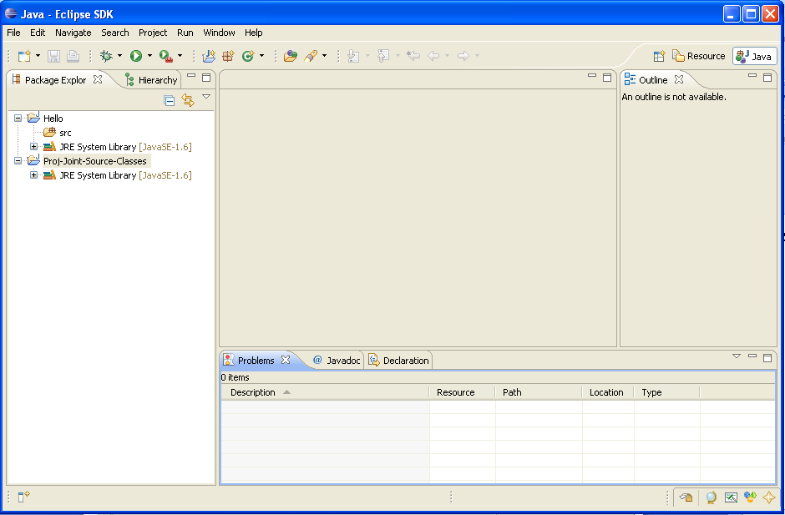
Java perspective

Slide 21
The Java quick tour in Eclipse:
Creating a Java project
New Java Perspective appears
  containing Package Explorer view (instead of the similar Project Explorer view) with two new projects
    Hello and
    Proj-Joint-Source-Classes;
  Package Explorer
    understands Java packages and
    displays them as a single entry rather than as a nested set of directories (as we will see soon).

Slide 22
The Java quick tour in Eclipse:
Creating a Java class
It is a good practice to organize Java classes into packages. (We will see this later also in Ant.)
Why?
  Packages allow groups of classes to control inter-class scope (allowing you to have a public façade interface and all other classes hidden)
  Packages allow you to re-use class names, for example there is a special Java SQL Date class used to wrap a SQL Date type
Package naming
  Should be meaningful
  For public code you can invert domain names:
    comp201.csc.liv.ac.uk
  Will become package
    uk.ac.csc.comp201
Notes:
org.eclipseguide.hello

Slide 23
Packages and directories
Source files/class files should be stored according to package name
So if the source file starts with
  package uk.liv.csc.comp220
  It will be stored in
  src/uk/liv/csc/comp220 directory
This allows the JVM to “find” the classes when running your program
If the file is zipped into jar directory structure is also stored

Slide 24
The Java quick tour in Eclipse:
Creating a Java class
In Java perspective , follow these steps to create new Java program (class):
  Right-click on the project name Hello and select
  New > Class
  Enter the package name like org.eclipseguide.hello (actually, use your personal package as described above!!)
  Enter the class name HelloWorld
  Check stub method :
    public static void main(String[] args)
  Check “Generate comments”
  (see next slide)
Notes:
org.eclipseguide.hello
HelloWorld

Slide 25
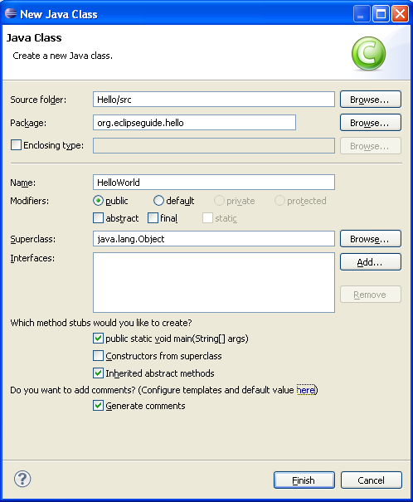
  Pay attention to the automatically chosen source folder
  Hello/src
  Click Finish, and look at the automatically generated result in the next slide.

Slide 26
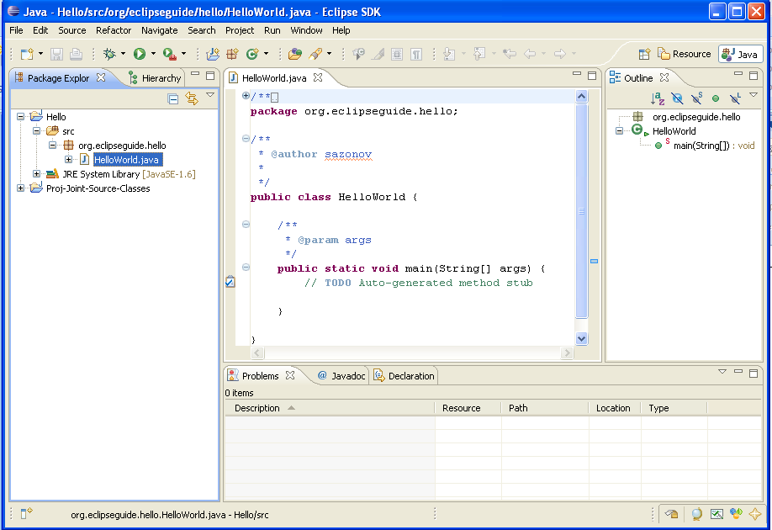
Notes:
Old picture

Slide 27
The Java quick tour in Eclipse:
Creating a Java class
Examine:
  Contents of the workspace directory
    - in your lab machines it should be
  H:\eclipse
  Package Explorer view in Java Perspective,
  Project Explorer view in Resource Perspective.

Slide 28
The Java quick tour in Eclipse:
Creating a Java class
Pay attention how the package and files HelloWorld.java and HelloWorld.class are posed in directories/views.
Note that neither Resource Perspective nor Java Perspective show default bin directory for compiled classes.
In the editor area we see the stub Java code HelloWorld.java (with an empty main() method) generated by the wizard.
Notes:
(analogous to our build\classes directory in the case of Ant considered later)

Slide 29
The Java quick tour in Eclipse:
Creating a Java class
Code-completion/code-generation features:
  Add a line to main() method System.out.println("Hello, World!");
  Eclipse helpfully inserts closing parentheses and double quotation marks;
  Code-completion feature, code assist, presents a list of proposals – the methods and attributes for the class;
  Code assist may also be invoked by Ctrl-Space;
  For example, type sysout followed by Ctrl-Space to get System.out.println();
  These features are easy to customize via Eclipse’s settings and preferences as we will see later.
Notes:
System.out.println("Hello, World!");

Slide 30
The Java quick tour in Eclipse:
Creating a Java class
Repeat the same in the project
Proj-Joint-Source-Classes
  This project directory (unlike Hello project) serves as joint directory for source code and for compiled classes.
  USE the same package name as above and similar class name Hello to HelloWorld.
We will use this project and new Hello class later.
Notes:
org.eclipseguide.hello
Hello
System.out.println("Hello!");

Slide 31
The Java quick tour in Eclipse:
Running a Java program
Select HelloWorld source in the editor – click.
To run this program,
  select Run > Run As > Java Application.
Eclipse can prompt you to save changes before it runs the program.
  Click OK.
Console view appears and displays the program output:
Hello, World!
Notes:
either
select Run > Open Run Dialog… and configure the launch settings (Create, manage and run configurations) ;
or, alternatively, in our simple case,

Slide 32
The Java quick tour in Eclipse:
Running the Java program
To re-run the chosen file, click Run button
or select
  Run >
  or hit
  Ctrl+F11,
No separate step is required to compile!
Compiling goes while editing!

Slide 33
The Java quick tour in Eclipse:
Syntax Errors
Eclipse JDT includes a special incremental compiler and evaluates your code as you type it,
  by creating .class file automatically.
It can highlight things such as syntax errors and unresolved references as you type.
TRY it:
  by deliberately creating some syntactical errors,
  and experimenting with red signs in the left and right border of the editor.

Slide 34
The Java quick tour in Eclipse:
Debugging the Java program
Eclipse interprets the code in a more comprehensive way than a simple editor can.
Eclipse’s ability to run the code interactively is one of major benefits.
By using the JDT debugger, you can
  execute your Java program line by line and
  examine the value of variables at different points in the program.
This process can be invaluable in locating problems in your code.
(Window > Open Perspective > Other… > Debug).

Slide 35
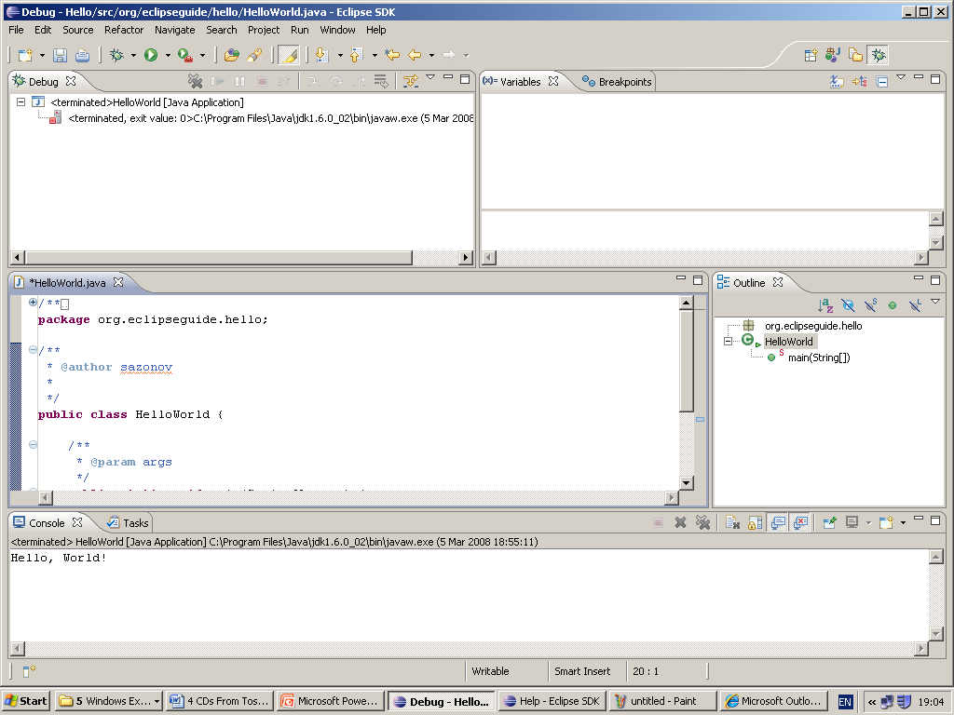
Debug perspective

Slide 36
The Java quick tour in Eclipse:
Preferences and other settings
Eclipse’s default settings can be changed or restored by selecting
Window > Preferences…
These are, for example,
  Code Style: Java>Code Style
    formatter,
    code templates for generating code or comments,
  Adding classpath entries and User Libraries via
  Java>Build Path
We will consider only some of these settings.
Notes:
Colours and Fonts displayed via General>Appearance,
General>Appearance>Colors and Fonts
Java>Code Stile
Java>Build Path

Slide 37
The Java quick tour in Eclipse:
Preferences and other settings
Exporting and importing preferences can be done via
File > Import > General > Preferences
File > Export > General > Preferences
Javadoc comments may be changed as follows:
  Select
    Window > Preferences > Java > Code Style > Code Templates
  Select Code > New Java Files, and click Edit
  Change the text to the following (by using Insert Variable buttons):
  /* ${file_name}
  * Created on ${date}
  */
  ${filecomment}
  ${package_declaration}
  ${typecomment}
  ${type_declaration}
  Click OK in the Edit Template dialog box
  (continued on the next slide)
← Added
← Original
Notes:
TO BE ADDED:
/* ${file_name}
* Created on ${date}
*/

Slide 38
The Java quick tour in Eclipse:
Preferences and other settings
Javadoc comments changes (continued):
  Select Comments > Types (in the same box), and click Edit
  Change the text to the following:
    /**
    * Add one sentence class summary here.
    * Add class description here.
    *
    * @author ${user}
    * @version 1.0, ${date}
    *
    * ${tags}
    */
  Click OK in the Edit Template dialog box
  Note, that you can always use Restore Defaults button.
  Click OK again.
To see all your changes, create a new class Test in org.eclipseguide.hello package with checking Generate Comments.
TRY it. (See the next slide for illustration of the above steps.)
Notes:
/**
* Add one sentence class summary here.
* Add class description here.
*
* @author ${user}
* @version 1.0, ${date}
*
* ${tags}
*/

Slide 39
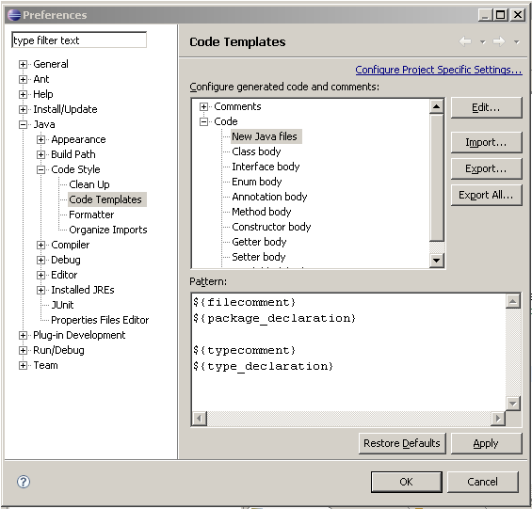
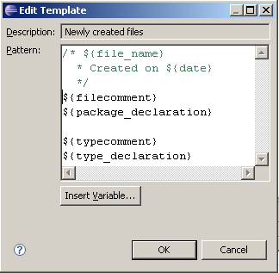
Changing
Javadoc comments
and code style
Notes:
OLD PICTURES

Slide 40
The Java quick tour in Eclipse:
Preferences and other settings
Format style
  Select Window > Preferences >
  Java > Code Style > Formatter
  Click Edit button,
  then choose, for example, Braces tab
  Choose one of the options:
  Same line, Next line, Next line indented, Next line on wrap
  and see how format style changes.
  (see the next slide)

Slide 41
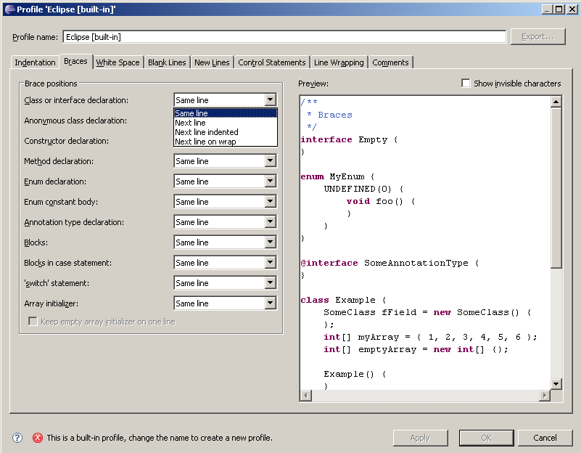
Changing Format style (brace positions)
Try
You will be prompted to change profile to, e.g., MyProfile
Notes:
OLD PICTURE

Slide 42
The Java quick tour in Eclipse:
Preferences and other settings
Code generation templates (to be invoked by Ctrl-Space).
  Templates for flow control constructs (like do while statement) are found in
  Window > Preferences >
  Java > Editor > Templates
  (see the next slide)

Slide 43
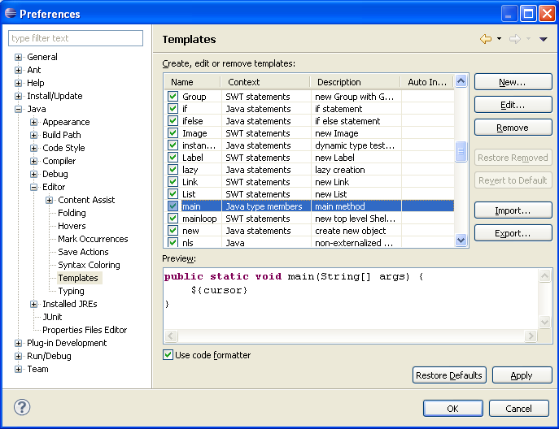
The Java quick tour in Eclipse: Preferences and other settings
Notes:
OLD PICTURE

Slide 44
The Java quick tour in Eclipse:
Preferences and other settings
Create template to produce
      simple for loop:
  Select (as above)
  Window > Preferences > Java > Editor > Templates
  Click the New button.
  Choose Context Java statements.
  Enter
    for as the name of new template,
    Simple for loop as the description, and
    the pattern on the next slide (by using Insert Variable):

Slide 45
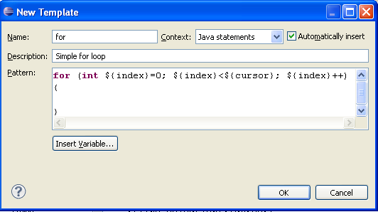
The Java quick tour in Eclipse: Preferences and other settings
  Finally,
    Click OK in this New Template dialog box,
    Click OK in the Preference dialog to return to the Workbench.
    TRY new version of for of Simple for loop just created with using Ctrl-Space.
Notes:
for (int ${index}=0; ${index}<${cursor}; ${index}++)
{
}

Slide 46
The Java quick tour in Eclipse:
Preferences and other settings
Setting Classpaths and classpath variables:
  Select Window > Preferences >
  Java > Build Path > Classpath Variables
  Click the New button.
  Enter the classpath variable name, (just for example), MYSQL_JDBC.
  Either browse or enter manually, (just for example, even if it does not exist in your computer) the path C:\mysql\jdbc\lib\mm.mysql-2.0.14-bin.jar
  Click OK twice to save and return to Workbench.
Notes:
MYSQL_JDBC
C:\mysql\jdbc\lib\mm.mysql-2.0.14-bin.jar

Slide 47
The Java quick tour in Eclipse:
Preferences and other settings
Adding JAR classpath or classpath variable (such as MYSQL_JDBC) to a project:
  right-click on the project name (Hello),
  select Properties, then Java Build Path, and Libraries tab, then
    either add the JAR explicitly by selecting Add External JARs… from your file system,
    or select Add Variable, click MYSQL_JDBC, and OK
In our case, MYSQL_JDBC points to non-existing location, so Eclipse does not allow to add this variable.
Similarly, we could add classpath variable JUNIT4_EXTERNAL (- external to Eclipse, which has its own JUnit3 and JUnit4) for our independent of Eclipse JUnit4
C:/JAVA/junit4.8.2/junit-4.8.2.jar
Alternatively, if we want to use Eclipse’s internal plugin for JUnit, we could click Add Library... and chose JUnit3 or JUnit4.
Notes:
Remove variable MYSQL_JDBC and corresponding class path in the same way, as we actually do not need them.

Slide 48
The Java quick tour in Eclipse:
Importing pre-existing Eclipse projects into workspace
Some Eclipse project (s) can be
  created by another developer or
  deleted from the workspace by yourself (without complete deleting the project contents on disk; e.g. you can temporary delete your Hello project and then import it back).
To import such a pre-existing Eclipse projects from some other workspace into your current workspace, select
File > Import > General >
> Existing Projects into Workspace > Next
  Choose Select Root Directory (i.e., a pre-existing - another or the current - workspace) containing existing projects and click Browse to find it.
  Choose project/subdirectory to import.

Slide 49
The Java quick tour in Eclipse:
Importing pre-existing Eclipse projects into workspace
You can additionally decide whether to Copy Projects into Workspace by ticking the appropriate box (if it is not in the current workspace) or not copy
That is, a content of a directory on disk can be dealt with as a part of our abstract Workspace but non necessarily physically contained in the Workspace directory on disk.
Click Finish.

Slide 50
The Java quick tour in Eclipse:
Conclusion notes
Thus, we know how to
  start a project in Eclipse,
  create a stub Java class by using a wizard,
  use the simplest Code-completion/code-generation features of the editor (Ctrl-Space),
  run and re-run a Java program in Eclipse,
  that Eclipse editor highlights and helps to correct syntax errors and unresolved references (discussed later),
  that Eclipse has a special Debug perspective to facilitate debugging a Java program (details omitted),
  use Preferences for
    code formatting style (positions of braces was considered)),
    templates for generating code (or comments – details omitted for self-study),
    adding classpath entries (details omitted for self-study),
    etc.
  import some pre-existing Eclipse projects into workspace

Slide 51
The Java quick tour in Eclipse:
Conclusion notes
Eclipse is available from
http://www.eclipse.org
Notes:
It was Eclipse 3.2.0. in Slides 2007
Eclipse 3.3.0. in Slides 2009
Eclipse 3.5.0. in Slides 2010
Eclipse 3.6.0. in Slides 2011
Nevertheless, it is a good book to read if you intend to use Eclipse in your practice of developing Java projects.

